Slide 1
Growth in HDR is 5 times growth in academic roles
Notes:
Choose the “Animations” Tab. In this tab
use “Path animations” to arrange the movement of the “stars”
use “Wipe” in the onset panel to create the lines and so forth

Slide 2
Notes:
After double clicking the map, use “Crop” to create subsections of this map—you can crop to shape, such as circles
Then, in the Animations tab, you can grow these cropped sections

Slide 3
HDR Peer
Finance Office
Notes:
You can somewhere make the screen very small—and then create a photo that is as big as the screen. Next, arrange this photo alongside many other photos of the same size. Then you can group these photos and shrink, using animations.

Slide 4
A token market of academic services
Editing
Networking
Statistics
Machine learning
Concise writing
Data linkage
Efficiency
Bayes
Grounded theory

Slide 5
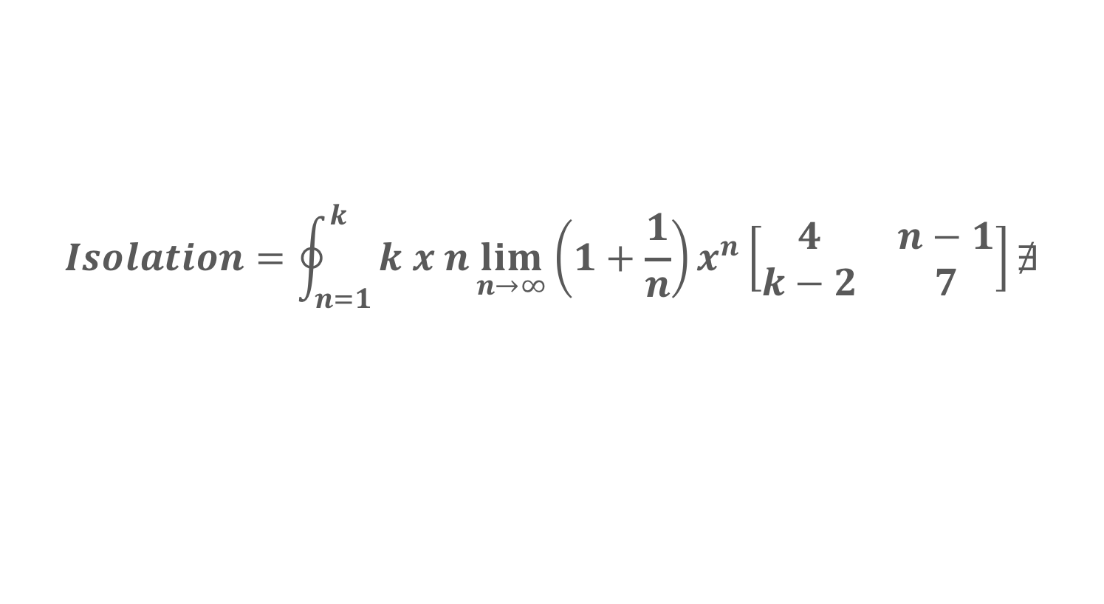
A formula
$$Isolation=\oint_{n=1}^{k}{k x n\lim_{n→∞}{{\left(1+\frac{1}{n}\right)x}^{n}\left[\begin{matrix}4 & n−1 \\ k−2 & 7\end{matrix}\right]∄}}$$
Notes:
This slide generates a balloon

Slide 6
This slide is easy to create

Slide 7
Do you like this effect?
Notes:
To create this effect, use “Path animation” in the “Animation” tab

Slide 8
A circular
arrangement
of pictures

Slide 9
Supervisors assume
the role of children
for a session
Notes:
This style might be especially helpful if you want to show a sequence of events
Image, “Old-phone”, from pickupimage.com, no date, Licenced under Creative Commons, CC BY, accessed 21 October 2019, https://snappygoat.com/b/f245de446cb368eb4d966b69fb3bc92d894d0d78

Slide 10
Introduction
The aim of this thesis is to explore the notion that PhD candidates become more motivated after they read a thesis of a final year peer. The reasoning behind this prediction revolves around the theory of future clarity. According to this theory, whenever individuals can envisage their future vividly—and feel this future is certain rather than unfeasible—their resilience and persistence improves.

Slide 11
Method
Participants
The participants will comprise 290 PhD candidates and 110 Masters by Research candidates. All these candidates had enrolled in this course within 3 months. Approximately 50% of these candidates had completed an Honors degree; 24% of these individuals had completed a Masters by Coursework degree,

Slide 12
Method Part 2
Measures
To assess future clarity, individuals completed five items, validated by Smith and Jones (2015). A typical item is “I perceive my future as vague”. All the items are reversed scored. Past research indicates that Crobach’s alpha = .83. Furthermore, to assess concurrent
Notes:
This book effect is easy to create—and is one of the “Transition” options

