Slide 1



Research proposals

Slide 2


The research proposal
Outline the problem or controversy you want to solve
Indicate how your research might uniquely resolve this problem
Overview
Lit review
Methods
Ethics
Legal & safety
Plans
Budget

Slide 3
The research proposal
Demonstrate the prevalence or significance of this problem
In a logical sequence, outline past attempts to resolve this problem
Integrate these attempts with supportive or refuting evidence
Specify or imply the limitations of past research
Present your research questions, aims, or even hypotheses
Overview
Lit review
Methods
Ethics
Legal & safety
Plans
Budget

Slide 4
The research proposal
First summarize the methodology and methods briefly
Discuss the philosophy, theoretical perspective, and methodology, if qualitative
Stipulate the participants, materials, procedures, and analysis of the first study
If applicable, describe the other studies too, but perhaps briefly
Justify uncommon choices
Overview
Lit review
Methods
Ethics
Legal & safety
Plans
Budget

Slide 5
The research proposal
Discuss how you will manage ethical concerns, such as whether
the research entails deception
participants might feel obliged to participate
incentives are disproportionate
Overview
Lit review
Methods
Ethics
Legal & safety
Plans
Budget

Slide 6
The research proposal
Consider legal or safety concerns, such as
whether you will need to transfer intellectual property to a research partner
how you will manage the risks of travel
Overview
Lit review
Methods
Ethics
Legal & safety
Plans
Budget

Slide 7
The research proposal
Present an outline of scheduled activities and communication plan that may include
the titles and outlets of publications
conferences, events, and social media to communicate results
translation into policy and practice
Overview
Lit review
Methods
Ethics
Legal & safety
Plans
Budget

Slide 8
The research proposal
Specify resources you will need
Estimate the costs
Consider source of funds, if needed
Overview
Lit review
Methods
Ethics
Legal & safety
Plans
Budget

Slide 9
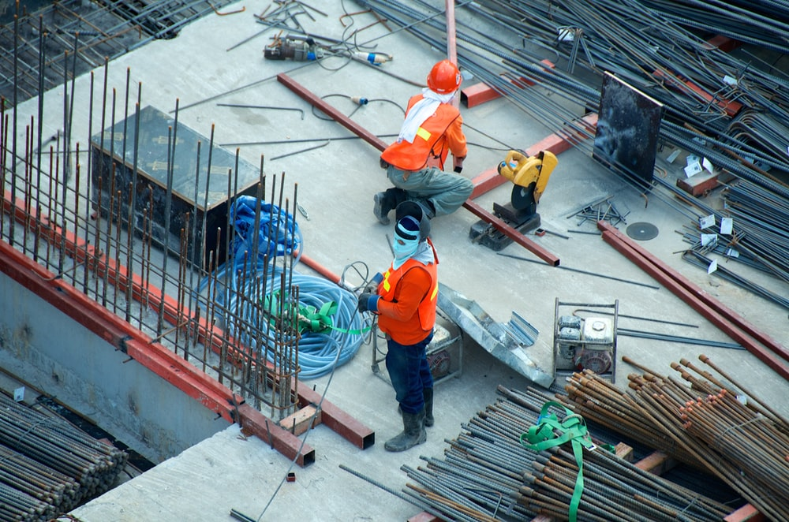
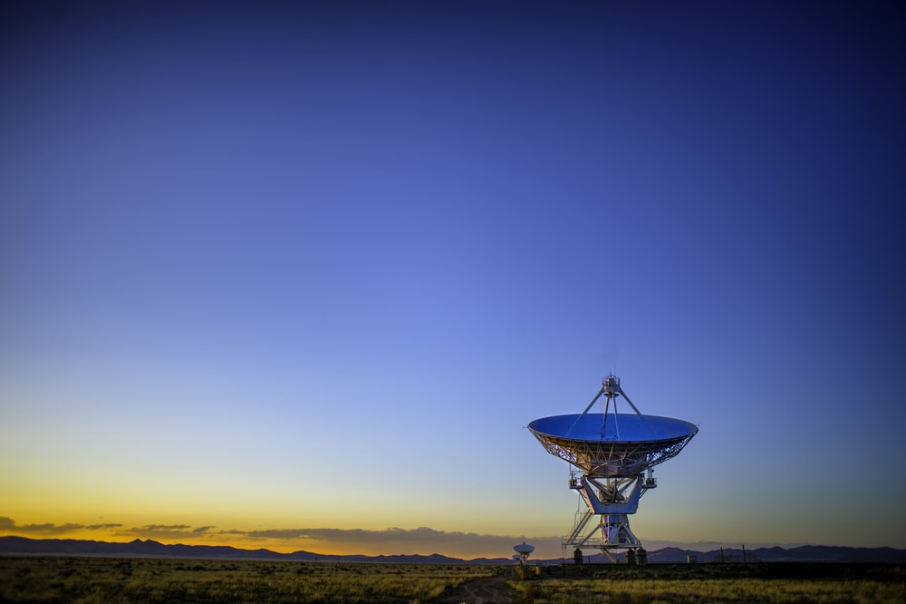
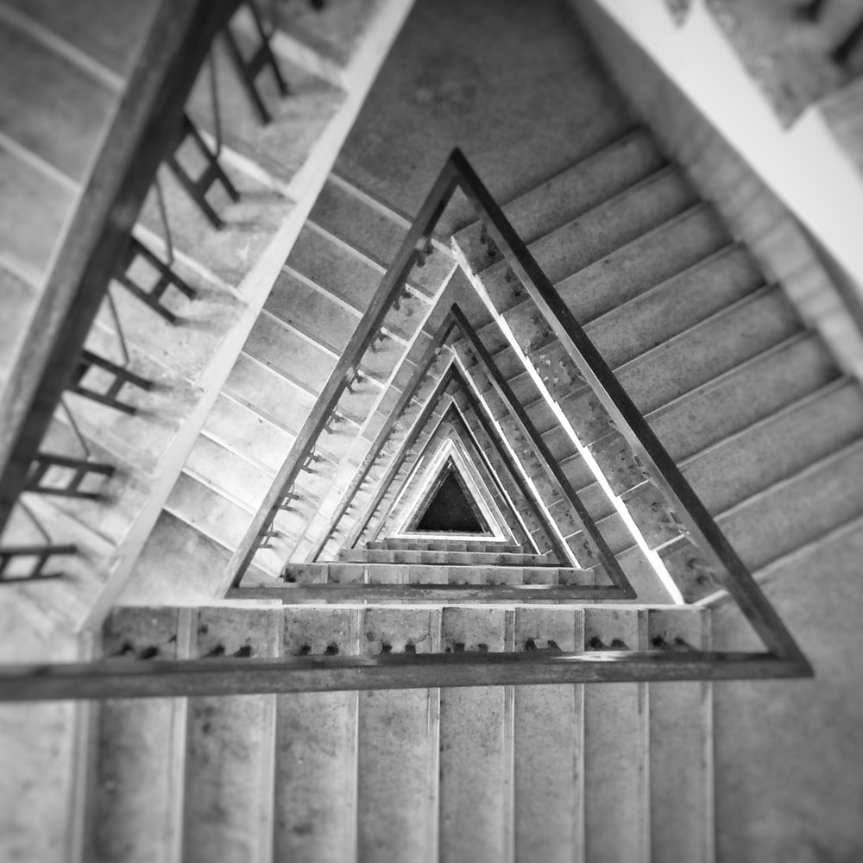
Background & foundations
Methods
Feasibility
Understands the topic
Aware of controversies
Research addresses a problem
Research is unique
Criteria to evaluate confirmation of candidature

Slide 10
Background & foundations
Methods
Feasibility
Understands the topic
Methods are suitable
Aware of controversies
Aware of limitations
Research addresses a problem
Specific philosophy & methodology
Research is unique
Plan to publish & apply
Criteria to evaluate confirmation of candidature

Slide 11
Background & foundations
Methods
Feasibility
Understands the topic
Methods are suitable
Enough time to collect data
Aware of controversies
Aware of limitations
Ethical, legal, & safe
Research addresses a problem
Specific philosophy & methodology
Resources are available
Research is unique
Plan to publish & apply
Supervisors are suitable
Criteria to evaluate confirmation of candidature

Slide 12



Relative to publications
Amount of data collection
Time to collect data
Is my research too limited or extensive?

Slide 13
Relative to publications
Amount of data collection
Time to collect data
PhD: 3 to 4 ordinary papers
Masters: 1 to 2 ordinary papers
Ordinary: Impact of 1 to 2
More in some disciplines
Different in creative fields
Is my research too limited or extensive?

Slide 14
Relative to publications
Amount of data collection
Time to collect data
Compare to other theses
Example: three surveys
Example: 20 interviews, 20 documents, personal observation
Is my research too limited or extensive?

Slide 15
Relative to publications
Amount of data collection
Time to collect data
Time to collect and analyze data
Include organizing and training
PhD: 9 to 12 months
Masters: 3 to 6 months
Convert to hours
Is my research too limited or extensive?

Slide 16
Constructing a budget
Notes:
To create this effect, use “Path animation” in the “Animation” tab

Slide 17
Significance of budgets
If underestimated, you might not receive the funds you need
If overestimated, your proposal may be perceived as too expensive

Slide 18
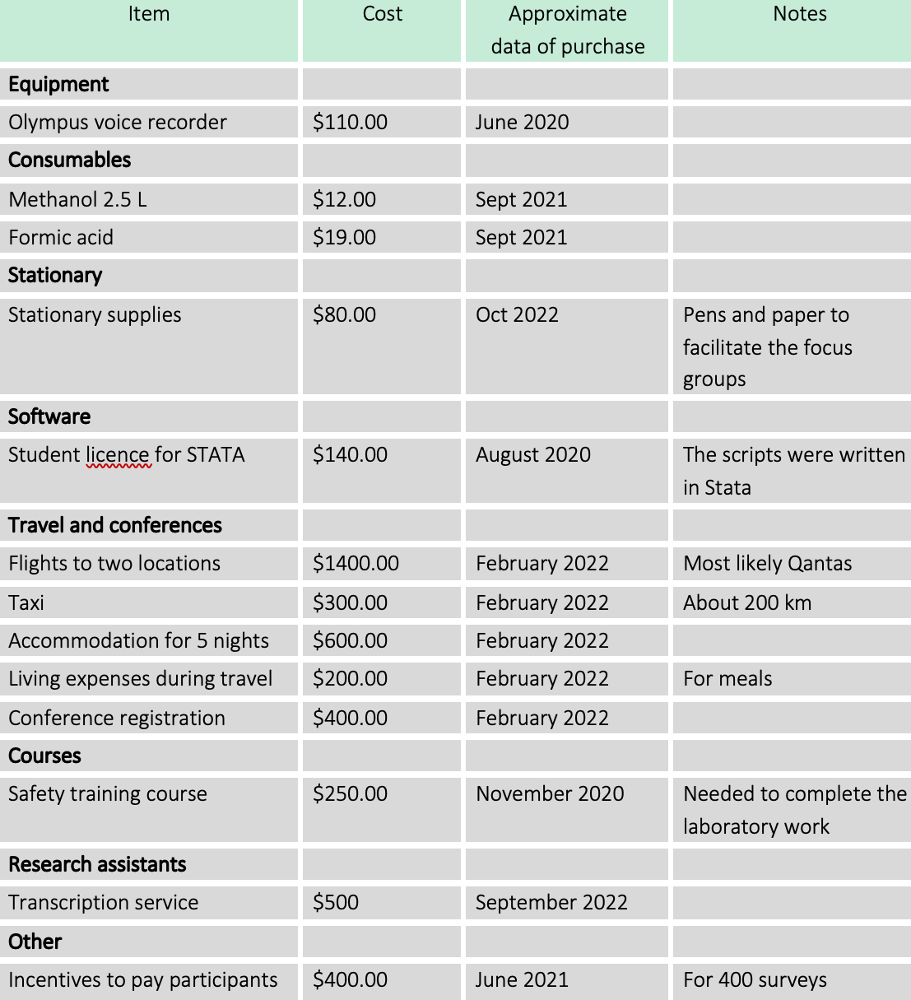
Key items
equipment & consumables,
stationary & software,
travel & courses
research assistants, recruitment

Slide 19
How to identify key items
seek precedents from your supervisor
contact your college admin to clarify previous or redundant purchases

Slide 20
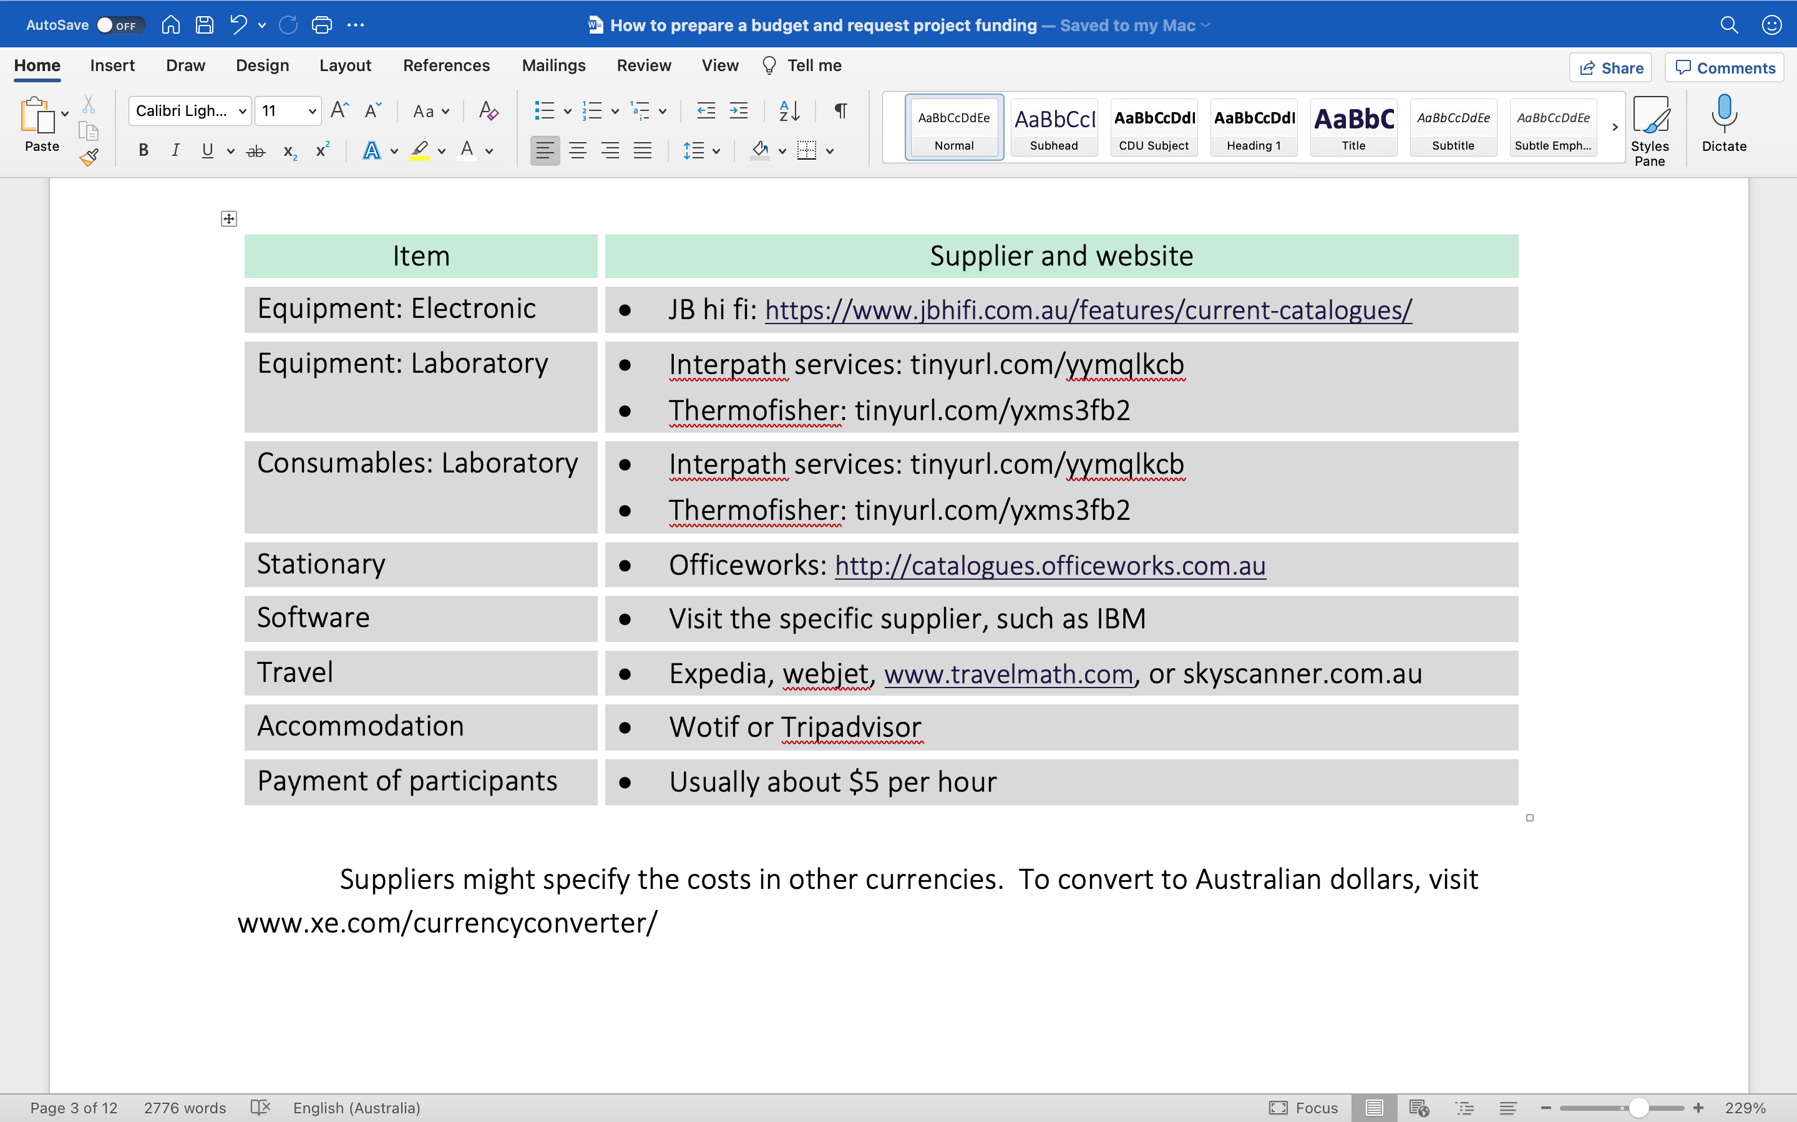

Slide 21
$1800
$3600
$5400
$7200
$9000
$10800
$12400
Funds you can utilize after each semester—if high cost
Funds you can utilize after each semester—if low cost
$800
$1600
$2400
$3200
$4000
$4800
$5400

Slide 22
$1800
$3600
$5400
$7200
$9000
$10800
$12400
Funds you can utilize after each semester—if high cost
Usually write to College or School admin—with approval from supervisor
Funds you can utilize after each semester—if low cost
$800
$1600
$2400
$3200
$4000
$4800
$5400

Slide 23
$1800
$3600
$5400
$7200
$9000
$10800
$12400
Funds you can utilize after each semester—if high cost
Suppose in Semester 2 you request more than you have accumulated but less than total
Funds you can utilize after each semester—if low cost
$800
$1600
$2400
$3200
$4000
$4800
$5400

Slide 24
$1800
$3600
$5400
$7200
$9000
$10800
$12400
Funds you can utilize after each semester—if high cost
College or School may consider exceptions
Funds you can utilize after each semester—if low cost
$800
$1600
$2400
$3200
$4000
$4800
$5400

Slide 25
Proposals versus presentations
We will orient attention more to the distinct features of presentations

Slide 26
Anecdote that inspired the topic
Specify the goal you want to achieve
Describe why you could achieve this goal
Briefly outline the research
Introduction
Literature review
Methods
Other

Slide 27

Anecdote that inspired the topic
Specify the goal you want to achieve
Describe why you could achieve this goal
Briefly outline the research
Human emotions & vivid images foster trust
Introduction
Literature review
Methods
Other

Slide 28
Anecdote that inspired the topic
Specify the goal you want to achieve
Describe why you could achieve this goal
Briefly outline the research
What problem do you want to solve?
Introduction
Literature review
Methods
Other

Slide 29
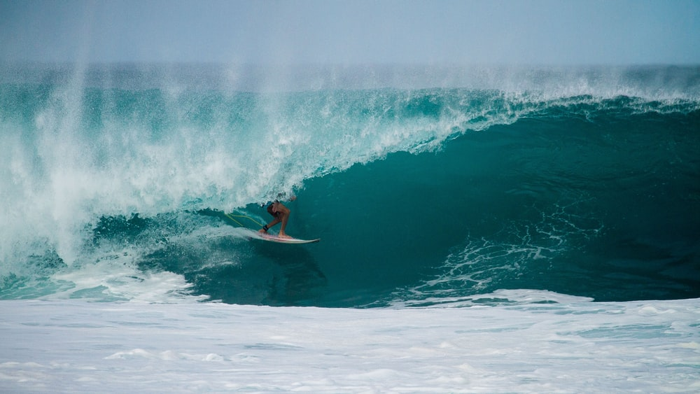
Anecdote that inspired the topic
Specify the goal you want to achieve
Describe why you could achieve this goal
Briefly outline the research
Consider a skill, opportunity, or passion—enhances your feelings of resilience too
Introduction
Literature review
Methods
Other

Slide 30

If allude to theory and approach now, seems more familiar and thus convincing later
Anecdote that inspired the topic
Specify the goal you want to achieve
Describe why you could achieve this goal
Briefly outline the research
Introduction
Literature review
Methods
Other

Slide 31
Highlight the impact of this problem
Summarize attempted solutions
Show limitations of solutions
Present more recent attempts
Show limitations of these attempts
Show how you resolve these obstacles
Specify your aim or even hypotheses
Could summarise in a table only
Introduction
Literature review
Methods
Other

Slide 32
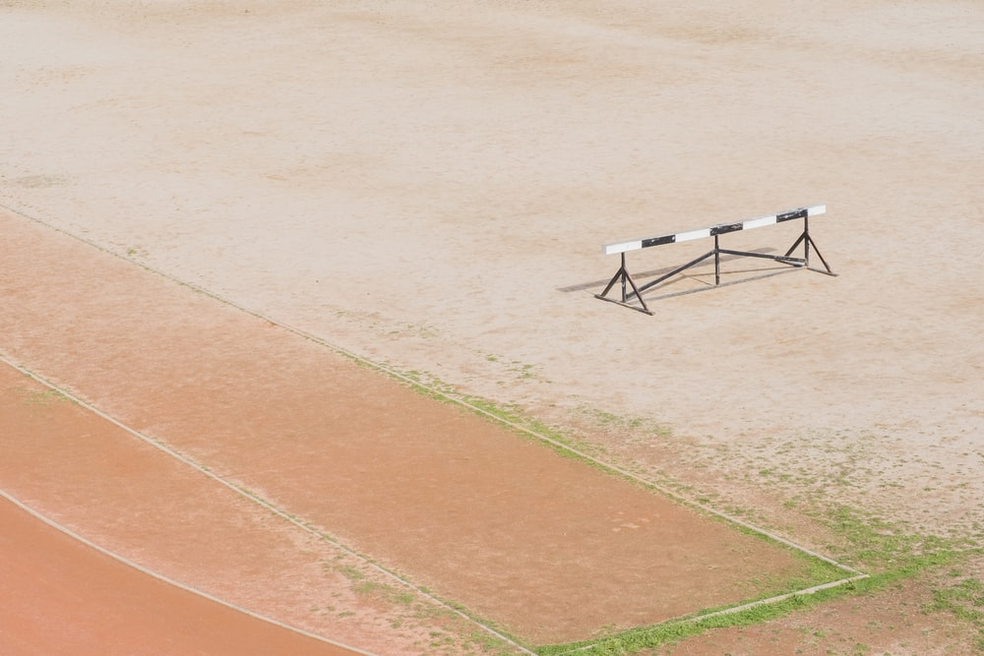
An approach that overcomes three problems is perceived as especially compelling
Highlight the impact of this problem
Summarize attempted solutions
Show limitations of solutions
Present more recent attempts
Show limitations of these attempts
Show how you resolve these obstacles
Specify your aim or even hypotheses
Introduction
Literature review
Methods
Other

Slide 33
Outline the methodology & methods
Describe the methods in detail
Describe how you will analyse data
Introduction
Literature review
Methods
Other

Slide 34
Outline the methodology & methods
Describe the methods in detail
Describe how you will analyse data
Introduction
Literature review
Methods
Other

Slide 35

Specify possible results
Discuss ethical, legal, & safety matters
Present a budget
Present a timeline
Vivid results
seem feasible
Introduction
Literature review
Methods
Other

Slide 36
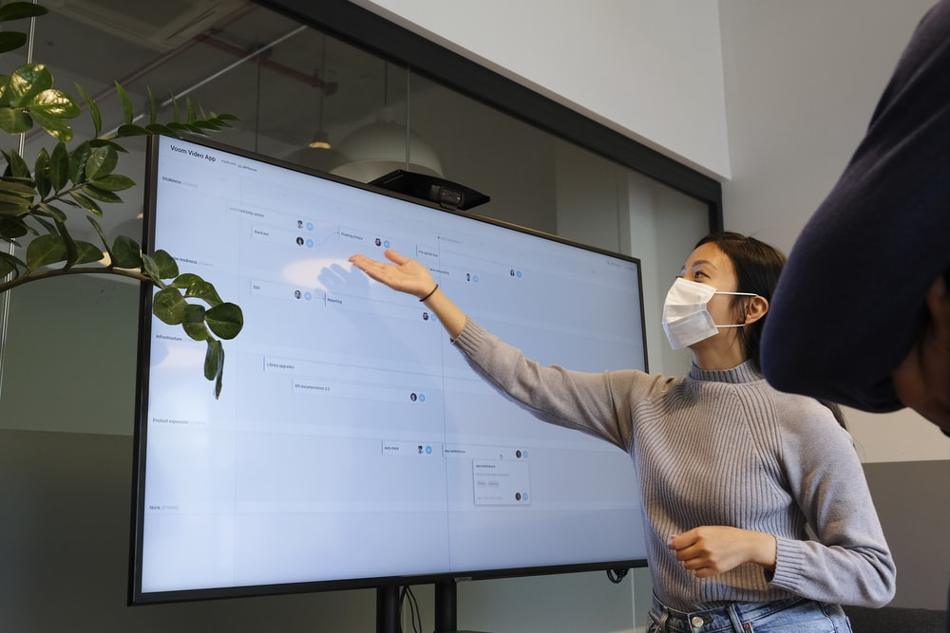
This slide illustrates a typical slide with
only a few keywords
highlighted keywords
a photograph or other aesthetic feature
a heading or taxonomy
Introduction
Literature review
Methods
Other

Slide 37



Mental preparation
Style
Answering questions
With eyes closed, describe your environment or sensations
Imagine yourself in a position of power, 10 years from now
Converse or imagining conversing with a supportive friend

Slide 38
Mental preparation
Style
Answering questions
To boost confidence, speak a bit louder and lower than usual
Stand with your hands and feet away from your midline
Smile at least occasionally—can enhance confidence too

Slide 39
Mental preparation
Style
Answering questions
Rephrase to emphasize a simpler issue
Express your first thoughts, like “This issue is similar to…”
Commit to explore this concern, after “We had considered…”

