Slide 1
Let’s Talk about Scholarships!
Orientation Week 2023
28 February 2023
3:00 – 3:30 pm
Office of Student Administration, Scholarship Team
Tu Ann Calinga

Slide 3

What are Scholarships?
Scholarships are financial aid designed to assist students while completing their studies.
Some scholarships also include funding for specific equipment, club memberships, and paid work placements to give students hands-on work experience.

Slide 4

Who sponsors our scholarships?
Our scholarships are sponsored by a range of individuals, businesses, government, community groups, and the university.

Slide 5
How many type of scholarships are there?
CDU Scholarships
First Nations Commonwealth Scholarships
External (non-CDU) Scholarships

Slide 6
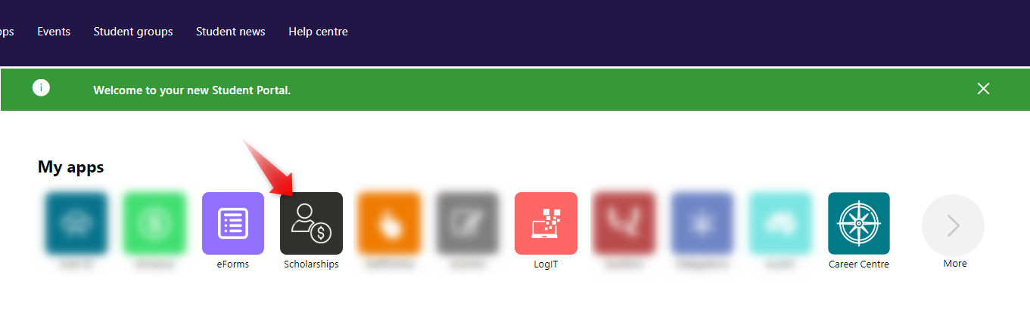
Where to find the Scholarships Finder?
For current students log into the student portal
Portal.cdu.edu.au

Slide 7
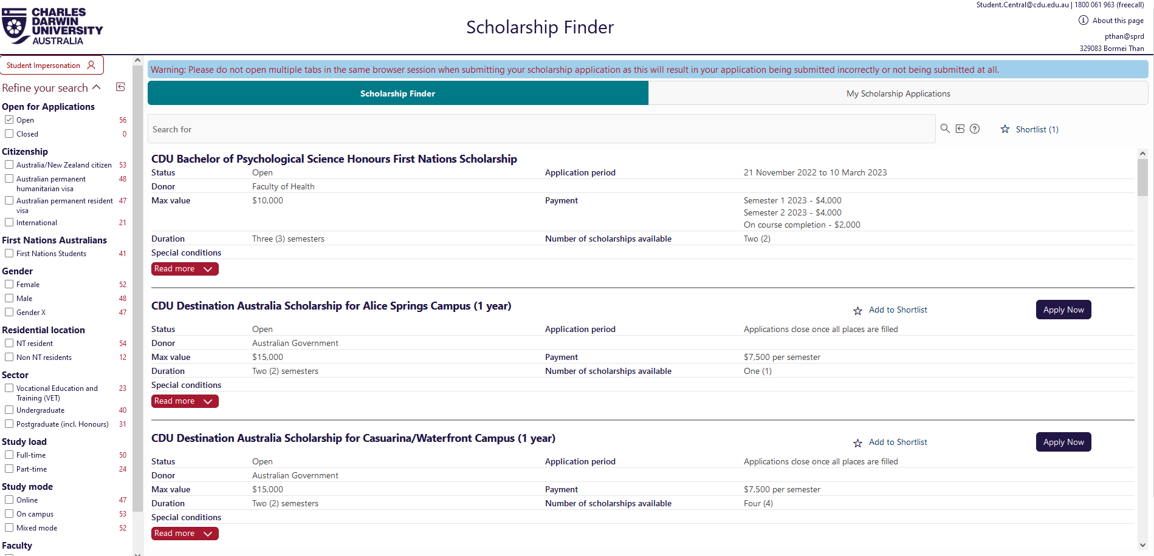



How to make an application
1

Slide 8
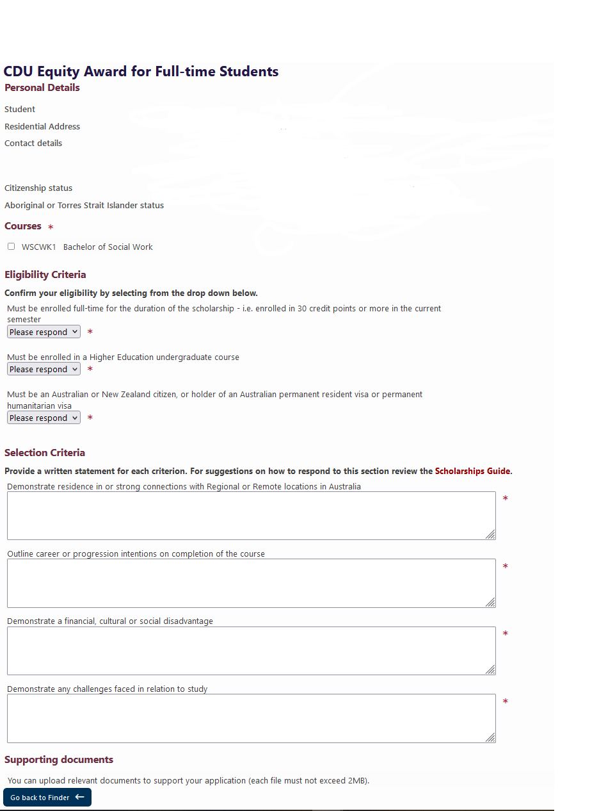



Slide 9
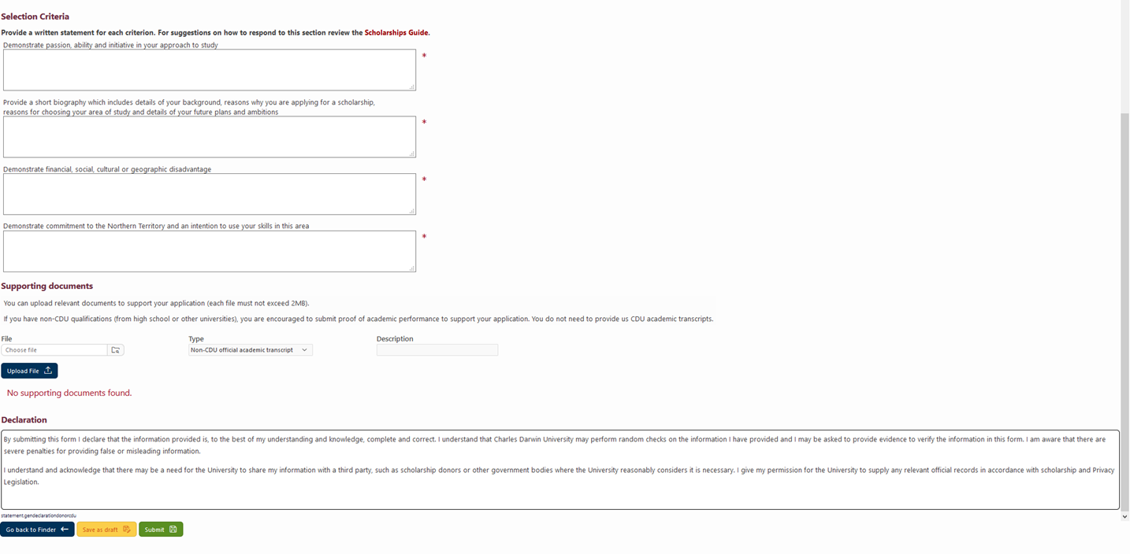



Slide 10
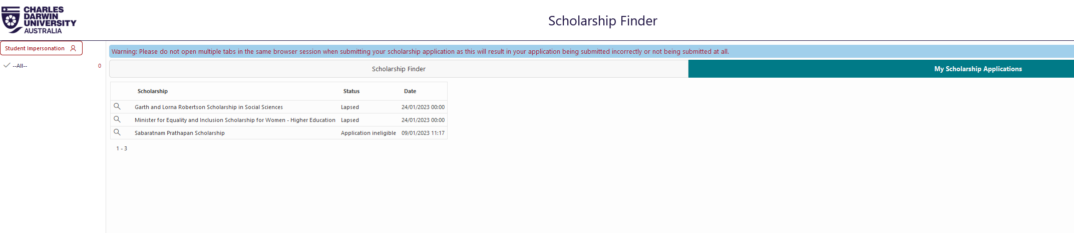

Slide 11

How to write a successful application
The Scholarship Committee rank applications on how well they address the selection criteria, usually by giving a score to each of the answers provided.
Only include your written statement in the provided boxes
Treat it like a job application – Who’s giving the scholarships? What is the purpose?
No spelling mistakes or incorrect grammar
Include all documents requested

Slide 12
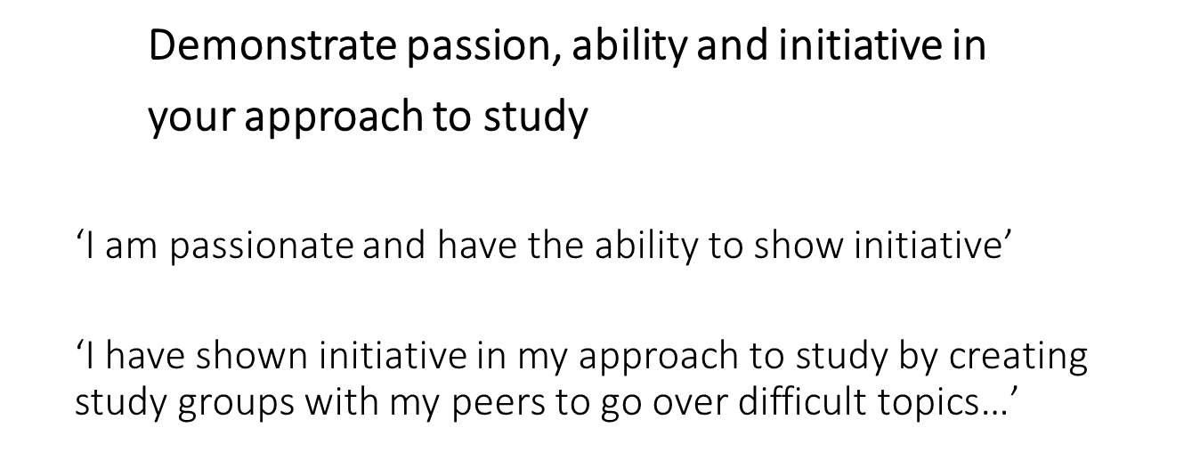


Addressing Selection Criteria
Use the selection criteria as headings and provide answer directly underneath;

Slide 13


Can students apply for more than one scholarship?

Slide 14

YES!!!
We encourage you to apply for all scholarships you are eligible for
Students can be awarded and hold up to two (2) scholarships at a time
If offered more than two scholarships in the same period, student can choose which two they’d like to accept

Slide 15
Successful Scholarship Recipients
CDU Progression rules must be met for ongoing scholarships:
-Pass more than 50% of units enrolled
-Not fail the same unit twice or more
-Maintaining credit average (subject to scholarship)
-A pass in all units (subject to scholarships)
Recipients are reviewed each semester to ensure they are meeting all requirements listed in the Terms and Conditions of the scholarship
Recipients must inform us of any change of circumstances

Slide 16

Scholarship Payment
All CDU Payments are made into the students bank account after the census date of each semester

Slide 17
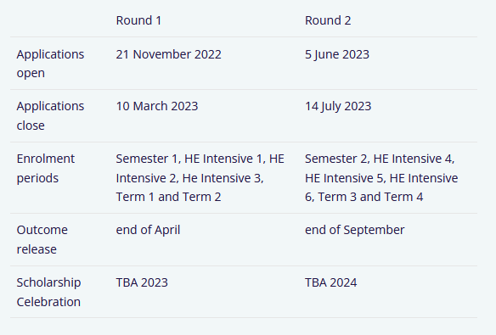
Scholarship Important Dates

Slide 18
Moving Forward
Our Scholarship team are always happy to assist with your query;
T: 1800 061 963
E: scholarships@cdu.edu.au
Or visit us at the Information Centre in Orange Building 1

Slide 19


