Slide 1
Welcome to Faculty of Science and Technology Sydney Campus​

Slide 3
Associate Professor Niusha Shafiabady T: +61 2 8047 4147 E: niusha.shafiabady@cdu.edu.au

Slide 4
Admission and Enrollment Support
The admission staff are located on level 10 reception
Kazi Jolly kazi.jolly@cdu.edu.au ;
Theresha Chrisshanti theresha.chrisshanti@cdu.edu.au ;
Nausheen Alam nausheen.alam@cdu.edu.au
Call: 0280474100

Slide 5
Student Central
www: https://www.cdu.edu.au/student-central​
E: student.central@cdu.edu.au​ FAQs: Ask CDU​ 1800 061 963 (freecall)​ Mon - Thurs: 8:30am - 4pm​ Friday: 8:30am - 3pm

Slide 6
You are going to study one of these courses: Master of Data Science, Master of IT (CS), Master of IT (IS) and Master of Project Management

Slide 7
The two units offered in Summer
PRT 551 (two slots Wed and Thursday morning)
HIT137 (two slots Wed and Thursday afternoon)

Slide 8
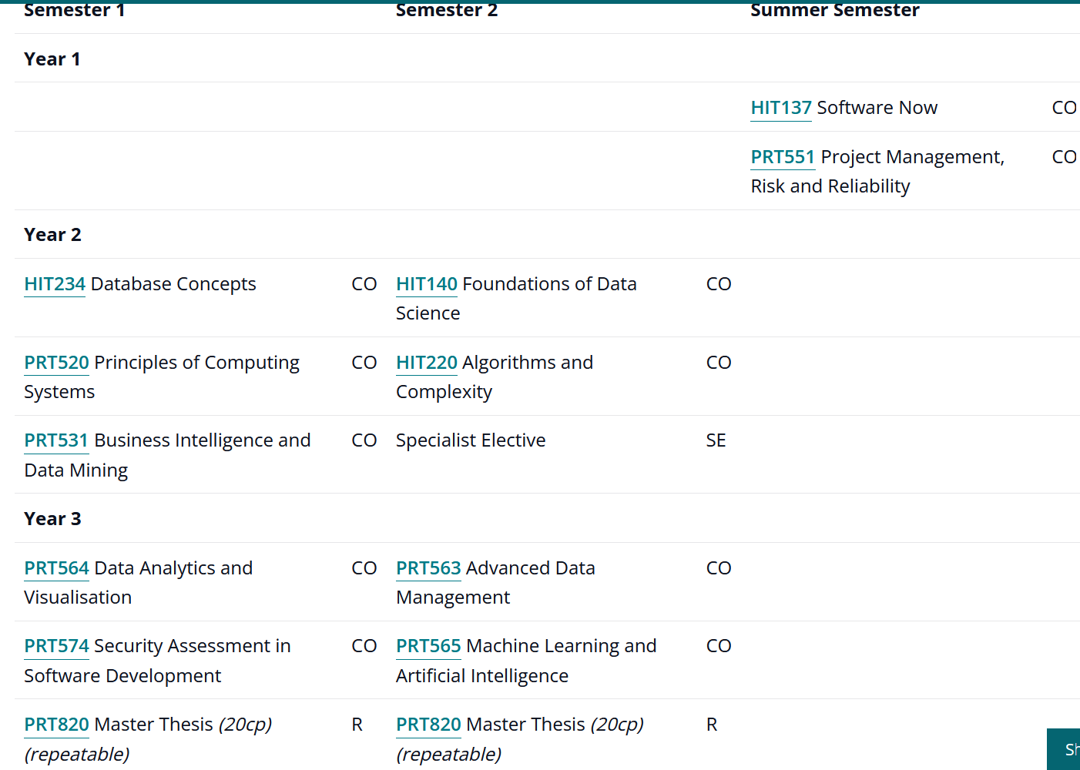
Course: Master of DS

Slide 9
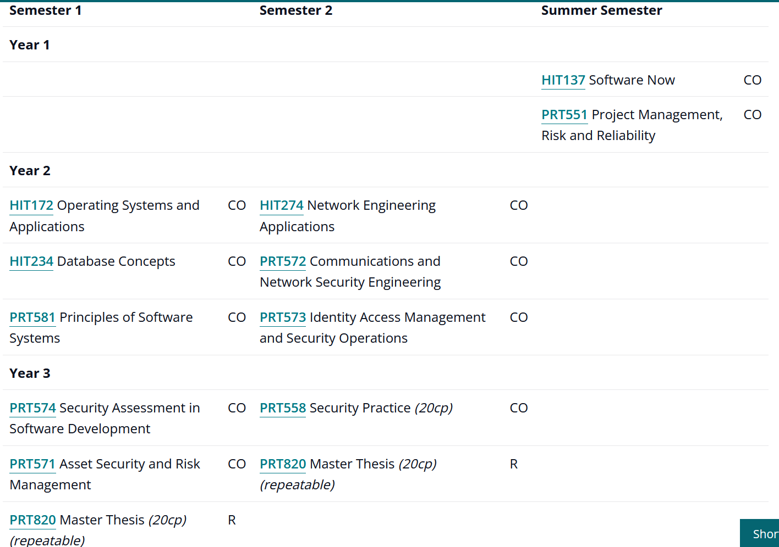
Course: Master of IT (CS)

Slide 10
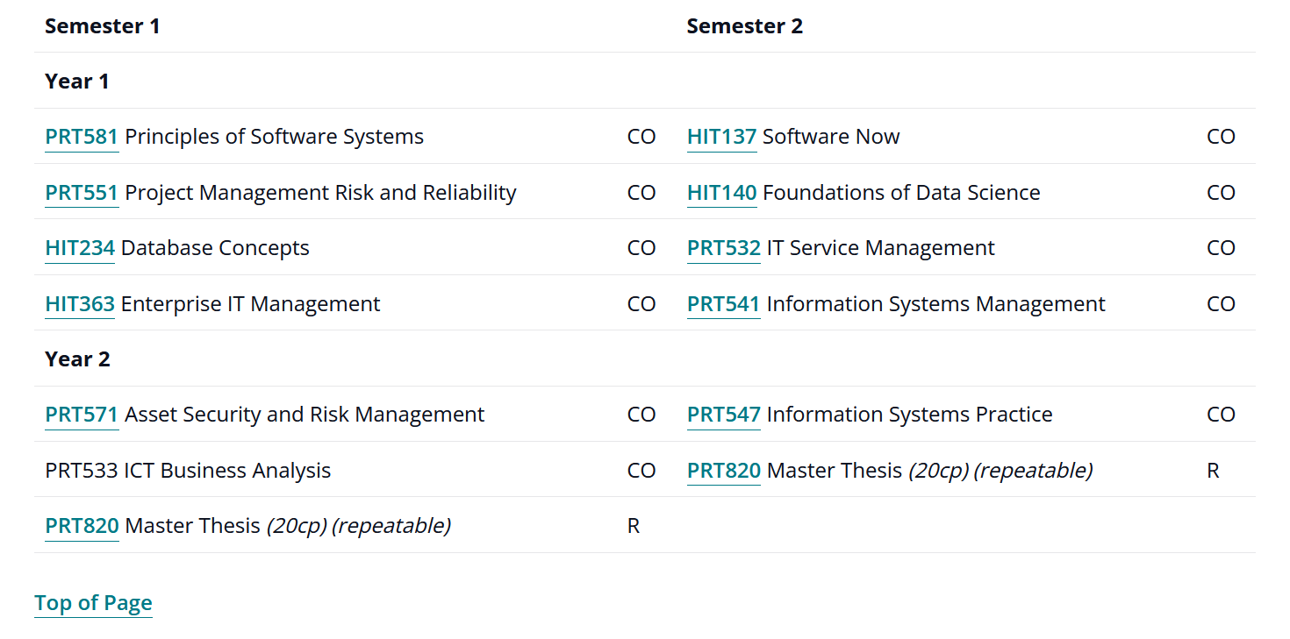
Course: Master of IT (IS)

Slide 11
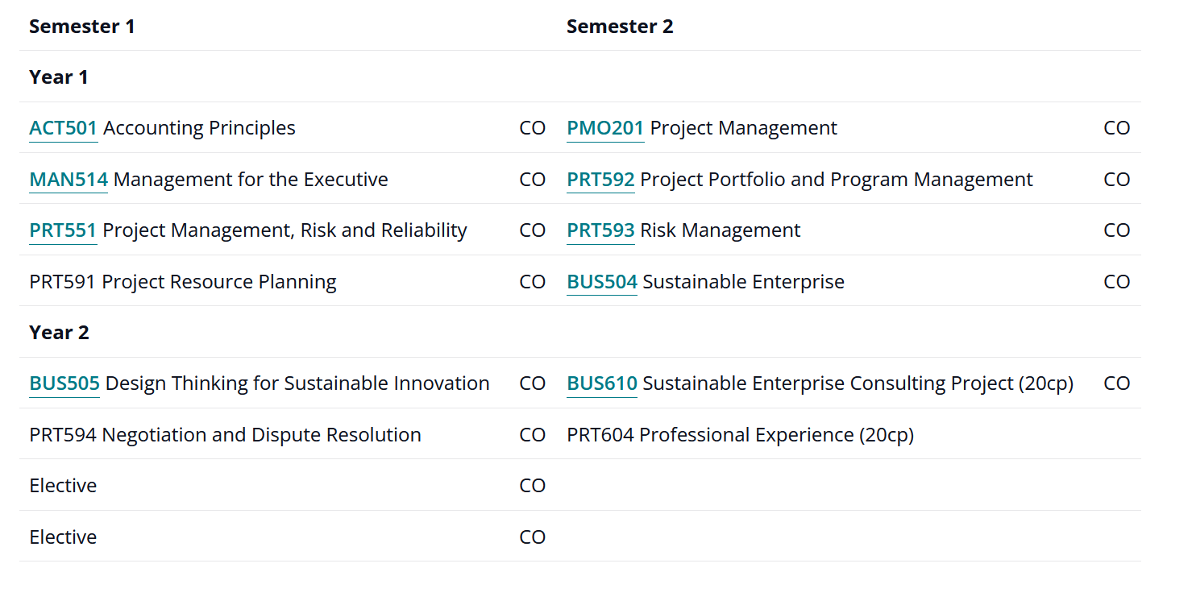
Course: Master of Project Management

Slide 12

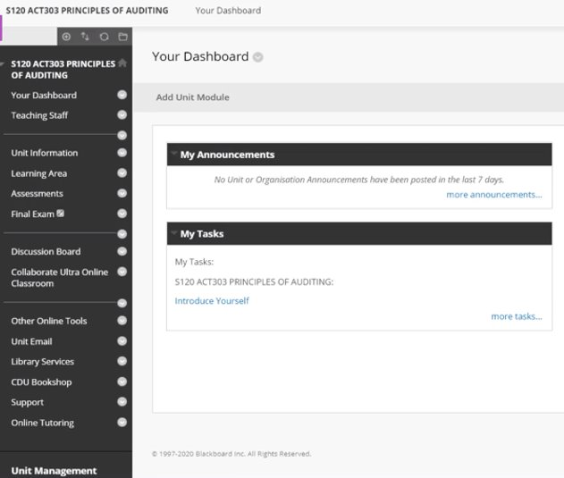
How you will learn
What can you find in Learnline?
Announcements, assessments, where you submit, live and recorded lectures, readings and unit guides.
*Have you watched the Learnline ‘how to’ session on the Orientation Website?​

Slide 13
Assessments
What are the expectations? i.e first 3 weeks leading to the first assessment
Quiz, online test, essays etc.
If unsure? Ask your lecturer (their email is on the learnline)
For summer units:
PRT551: James.Vakilian@cdu.edu.au
HIT137: Sheeraz.memon@cdu.edu.au

Slide 14
Library, L&L & Learnline tools
Including how to find:
Online tutoring *Did you know that this is 24/7
Library services
Language and Learning *Booking appointments, study skills page & workshops as shown on the website
Discussion boards to connect with other students
Specific areas for the course
*Don't forget to check out the recordings/presentations on the Orientation Website under the above headings

Slide 15
Placements
Year 2
EOI

Slide 16
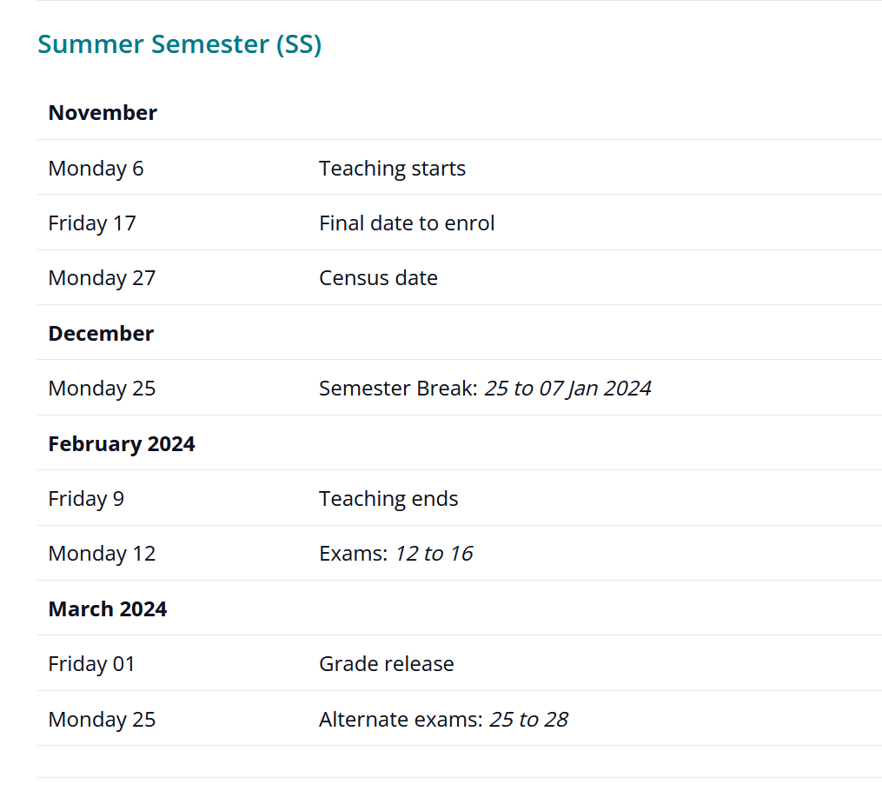
Important Dates / Don't forget!
Census date
Final day to enroll

Slide 17
How to get support from Admission team
Email of the admission team:
The admission staff are located on level 10 reception
Kazi Jolly kazi.jolly@cdu.edu.au ;
Theresha Chrisshanti theresha.chrisshanti@cdu.edu.au ;
Nausheen Alam nausheen.alam@cdu.edu.au
Call: 0280474100
All other support:​
https://www.cdu.edu.au/current-students

Slide 18
All the Best!
Working hard, Being focused on your studies and Good attendance is the key to success!

